Slide 1


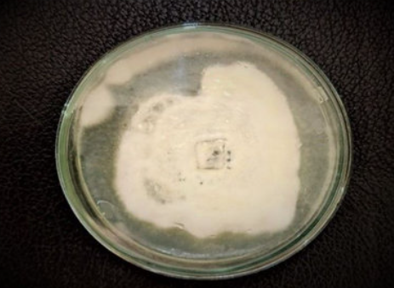

Hybrid Genome Assembly and Multi-Omics Analysis of Purpureocillium lilacinum PLA-C1 Reveals Bioplastic Degradation Potential
Martina Castellucci | A.Y. 2024/2025
MSc Bioinformatics
Applied Genomics Project

Slide 2
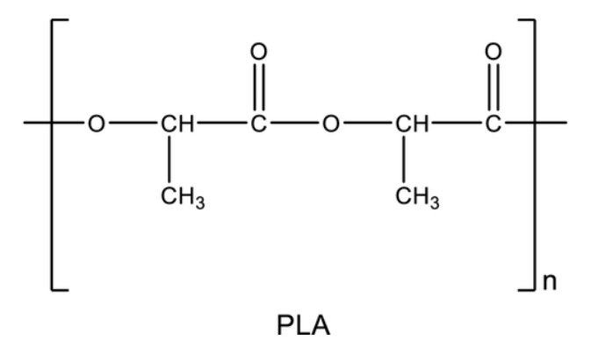
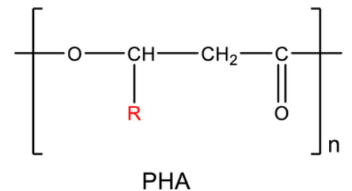



Scientific Context & Study Rationale
Background
PLA and PHA are widely used bioplastics but degrade slowly under natural conditions.
Filamentous fungi produce hydrolytic enzymes (esterases, cutinases, lipases) capable of polymer breakdown.
PLA-enriched compost acts as a hotspot for isolating potential plastic-degrading microbes.
Purpureocillium lilacinum is a nematophagous fungus with broad metabolic versatility.
Rationale
Identify genes and enzymes involved in PLA/PHA degradation.
Integrate genomic and transcriptomic data to support enzyme discovery.
Provide a molecular basis for bioplastic waste valorization and circular bioeconomy strategies.

Slide 3








Research Workflow Overview
1- Sample collection from PLA/PHA-enriched compost
2- Isolation & identification of P. lilacinum PLA-C1 (Rhodamine B assay + ITS sequencing)
3- DNA/RNA extraction and quality control
4- Hybrid sequencing: Illumina NovaSeq + Oxford Nanopore GridION
5- Genome assembly & polishing
6- Functional annotation (CAZymes, BGCs, degradative enzymes)
7- Comparative genomics and phylogenetic analysis
8- Transcriptomic profiling under PLA/PHA conditions
9- Integration of multi-omics for enzyme discovery

Slide 4
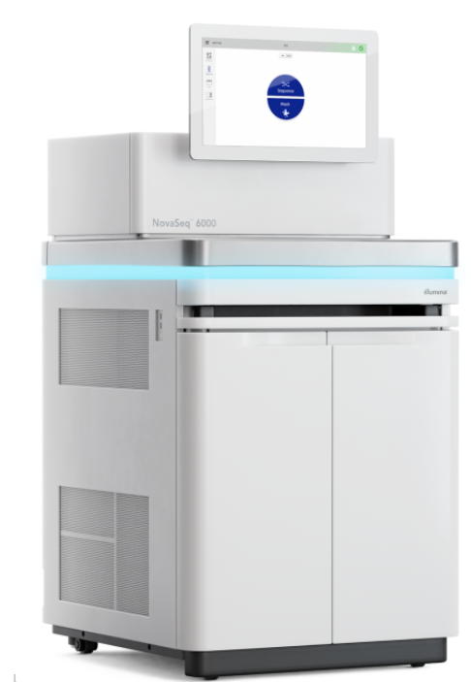
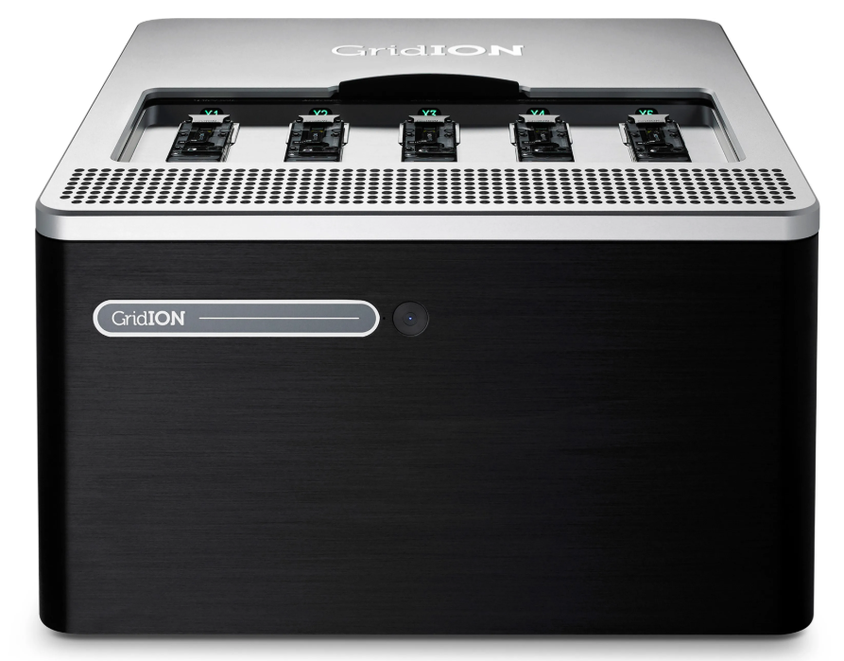
Hybrid Genome Sequencing Strategy
Feature | Illumina NovaSeq 6000 | Oxford Nanopore GridION
Read type | Short, paired-end | Long, single-molecule
Read length | 150 bp (PE150) | Up to 20 kb
Coverage in project | ~101× | ~35×
Accuracy | >99.9% (Phred > Q30) | ~90–95% (after polishing)
Strengths | High base accuracy, SNP detection, RNA-Seq | Resolves repeats, structural variants, improves contiguity
Main role in project | Error correction, polishing, transcriptome mapping | Primary genome scaffolding, structural resolution

Slide 5
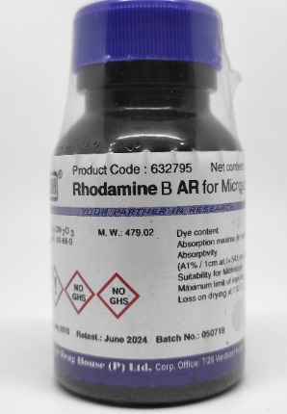
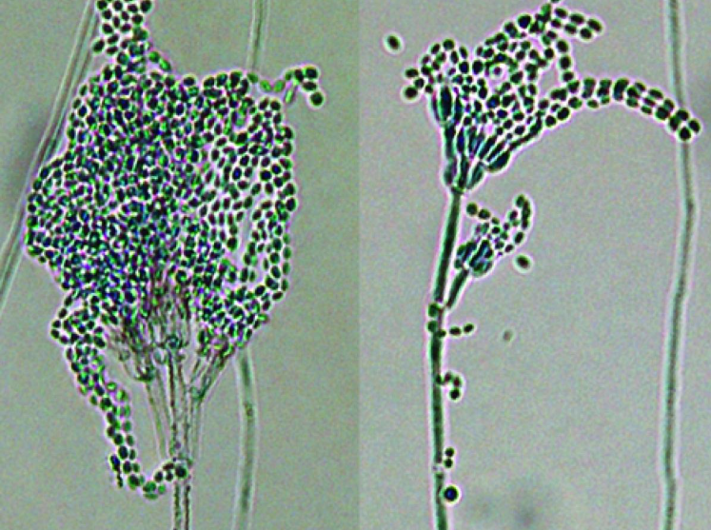
Collection and Identification
Compost from PLA/PHA-rich organic waste collected locally.
Cultured on PDA + 0.5% PLA + Rhodamine B
→ visible fluorescent halos = esterase activity.
Microscopy showed septate hyphae with conidia typical of Purpureocillium.
ITS rDNA sequencing confirmed taxonomic identity as P. lilacinum PLA-C1.

Slide 6
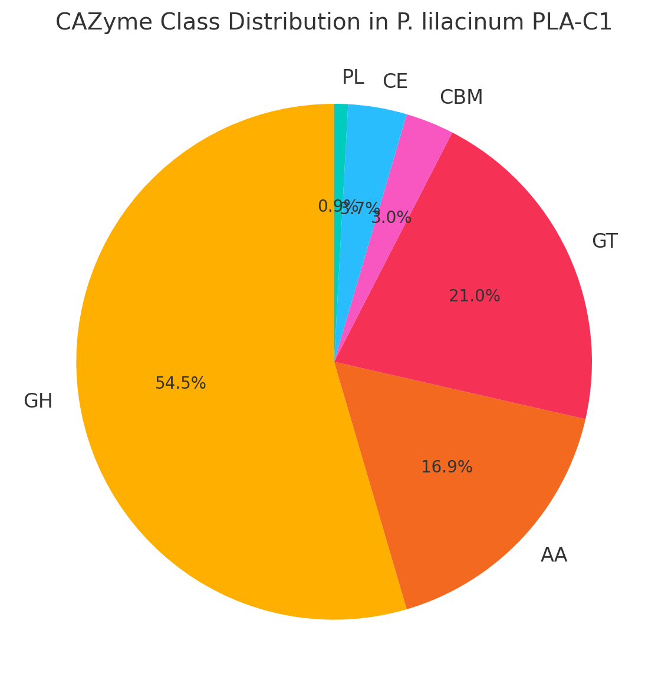

Hybrid Assembly & CAZyme Profile
Hybrid sequencing (Illumina + Nanopore) → high contiguity fungal genome.
Metrics: 38.6 Mb | 10 contigs | N50 = 5.3 Mb | GC = 58.5% | BUSCO completeness = 76.3%.
Annotation: MAKER3 pipeline with RNA-Seq support.
Identified 272 CAZymes across GH, GT, CE, AA, and CBM families — enzymes linked to polymer degradation.

Slide 7
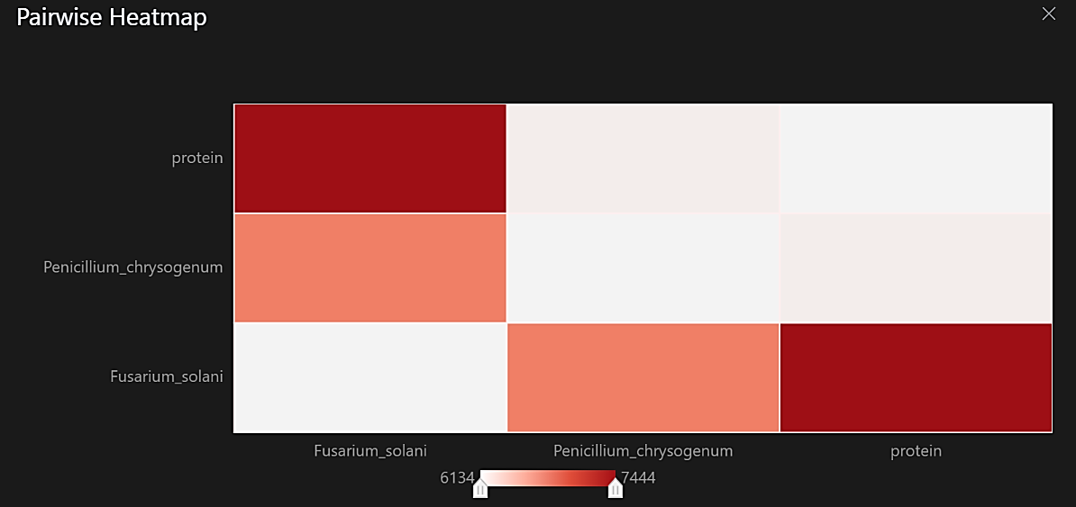
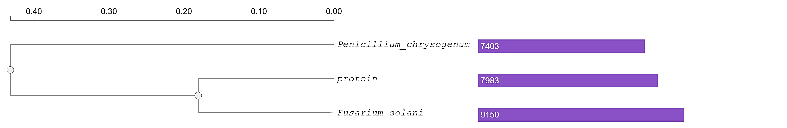

Genomic Comparison & Evolutionary Context
OrthoFinder: 10,312 shared orthogroups, 314 strain-specific genes.
MCScanX / MAUVE: genome collinearity with related fungi, detection of structural rearrangements.
Phylogenetic placement: PLA-C1 forms a distinct clade within Purpureocillium.

Slide 8
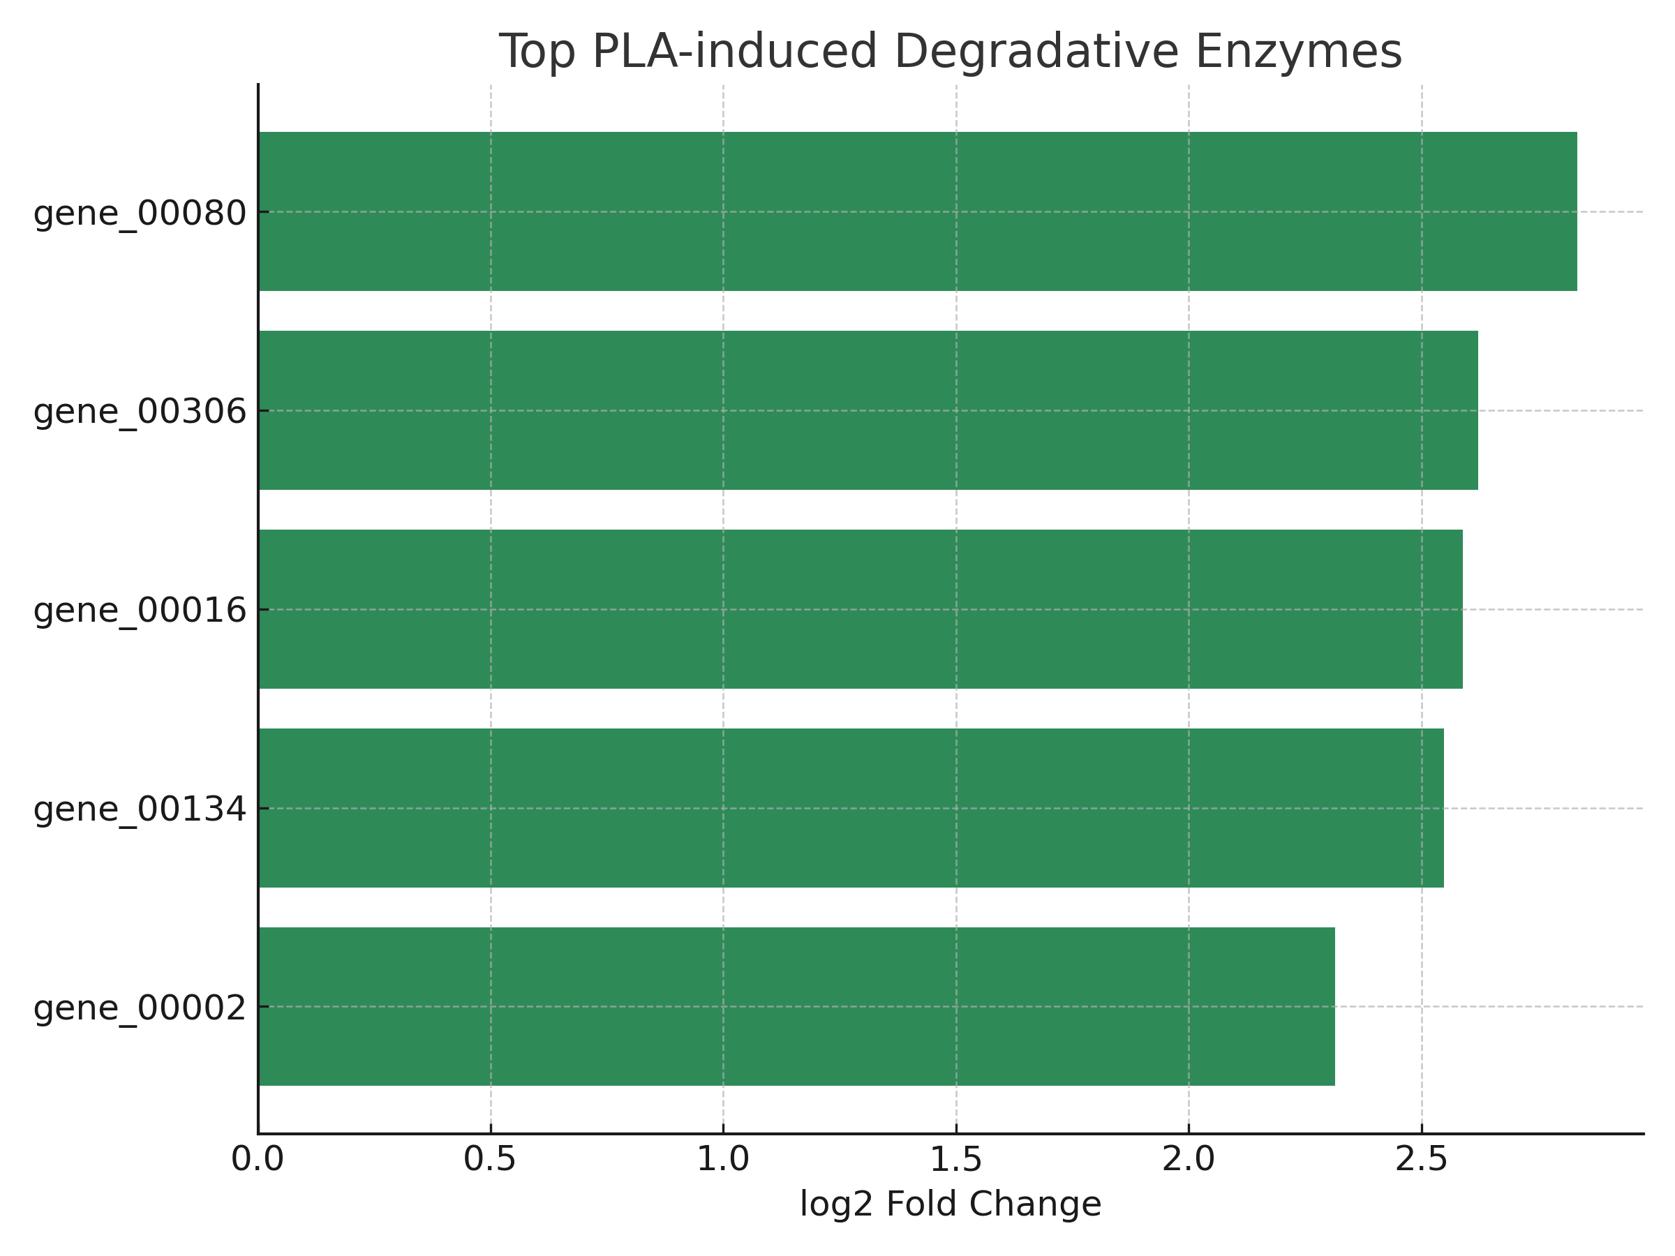
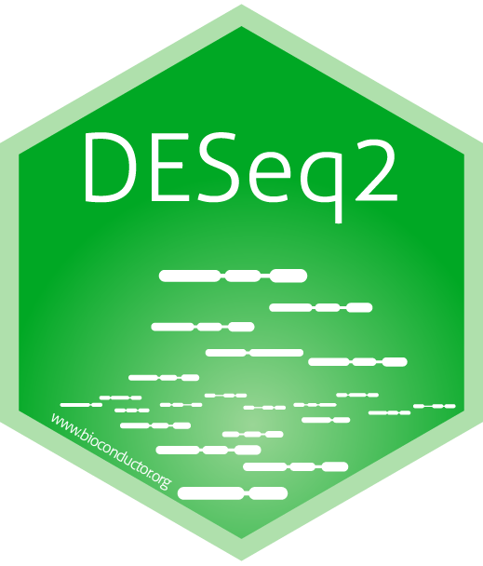
Gene Expression Response to Bioplastics
RNA-Seq performed on Control, PLA, PHA conditions (4 replicates each).
DEGs (FDR ≤ 0.05, |log₂FC| ≥ 2):
PLA vs Control: 84 genes.
PHA vs Control: 51 genes.
Shared PLA/PHA: 29 genes.
Many PLA-induced DEGs encode cutinases, esterases, lipases.

Slide 9



From Genome to Green Solutions
Strengths | Challenges
Targeted enzyme discovery enabling efficient PLA/PHA degradation | Scaling from lab to industrial composting facilities required
Multi-omics integration for mechanistic insights | Enzyme stability and efficiency under real environmental conditions
Alignment with EU Green Deal & Circular Economy Action Plan | Regulatory and safety assessments for field applications
Potential for industrial composting and waste valorization | Economic feasibility vs. conventional waste management
Creation of an open-access dataset for biotechnology R&D

Slide 10

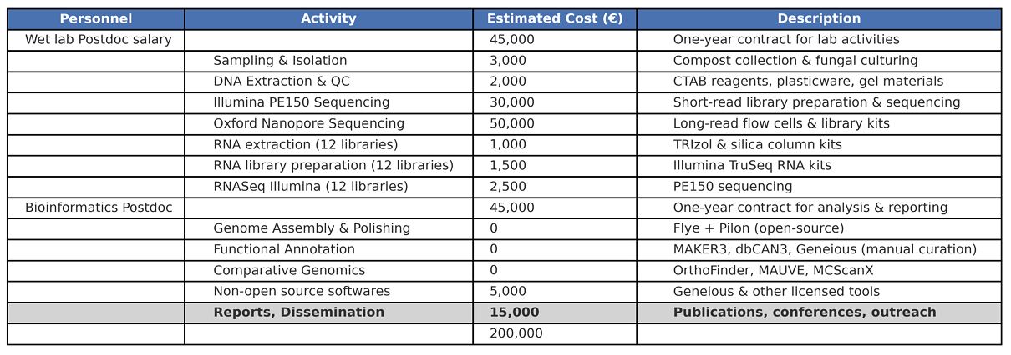
Estimated Project Budget

Slide 11

Selected References & Tools
Scientific Articles
Prasad et al. (2015) BMC Genomics, 16:1004 – Genome annotation of P. lilacinum.
Xie et al. (2016) Front. Microbiol., 7:1084 – Genome & transcriptome of nematophagous strain.
Li et al. (2024) Front. Microbiol. – Metabolic potential of deep-sea P. lilacinum.
Tseng et al. (2023) Appl. Microbiol. Biotechnol. – Biodegradation of PBAT by P. lilacinum.
Ekanayaka et al. (2025) J. Fungal Biol. – Review of plastic-degrading fungi.
Main Tools Used
Assembly: Flye, Pilon
QC: QUAST, BUSCO
Annotation: MAKER3, dbCAN3, Geneious (manual curation)
Comparative Genomics: OrthoFinder, MCScanX
Transcriptomics: Salmon, DESeq2
Visualization: R, Python Matplotlib, Geneious

